Slide 1

Learn the Flexbox

Slide 2
How does the FLEXBOX work?
FLEXBOX is a CSS layout mode that provides an easier way to arrange element within a container.
The biggest difference between Bootstrap 3 and Bootstrap 4 is that Bootstrap 4 now uses flexbox, instead of floats, to handle the layout.
The Flexible Box Layout Module, makes it easier to design flexible responsive layout structure without using float or positioning.
NO FLOATS
NO margin collapse
Order of elements is controlled from CSS
Easier to position child elements.

Slide 3
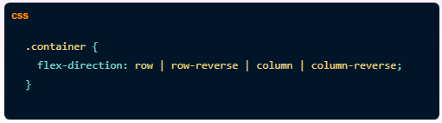
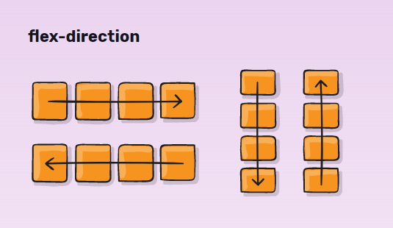
Flex Direction
This establishes the main-axis, thus defining the direction flex items are placed in the flex container. Flexbox is (aside from optional wrapping) a single-direction layout concept. Think of flex items as primarily laying out either in horizontal rows or vertical columns
row-reverse: right to left in ltr; left to right in rtl
row (default): left to right in ltr; right to left in rtl
column: same as row but top to bottom
column-reverse: same as row-reverse but bottom to top

Slide 4
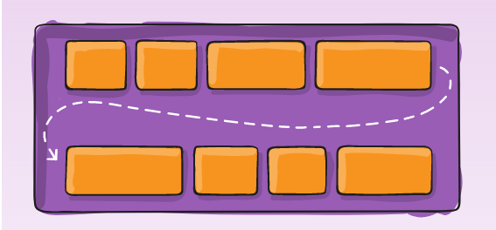
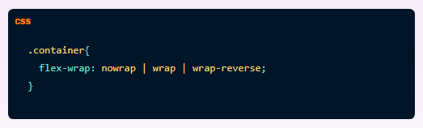
Flex-wrap
By default, flex items will all try to fit onto one line. You can change that and allow the items to wrap as needed with this property.
nowrap (default): all flex items will be on one line
wrap: flex items will wrap onto multiple lines, from top to bottom.
wrap-reverse: flex items will wrap onto multiple lines from bottom to top.

Slide 5
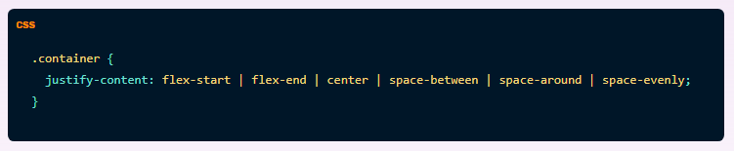
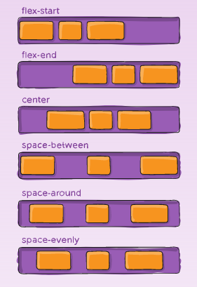
Justify-content
The justify-content property aligns the flexible container's items when the items do not use all available space on the main-axis (horizontally)
flex-start (default): items are packed toward the start line
flex-end: items are packed toward the end line
center: items are centered along the line
space-between: items are evenly distributed in the line;
first item is on the start line, last item on the end line
space-around: items are evenly distributed in the line with
equal space around them.
space-evenly: items are distributed so that the spacing between
any two items (and the space to the edges) is equal.
.

Slide 6
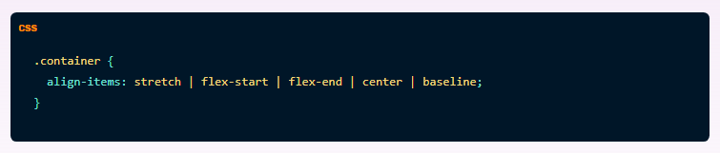
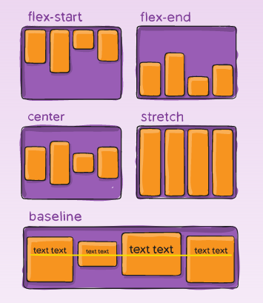
Align-Item
The align-items property sets the align-self property on all of the flex items as a group.
stretch (default): stretch to fill the container
(still respect min-width/max-width)
flex-start: cross-start margin edge of the items is
placed on the cross-start line
flex-end: cross-end margin edge of the items is
placed on the cross-end line
center: items are centered in the cross-axis
baseline: items are aligned such as their baselines align

Slide 7
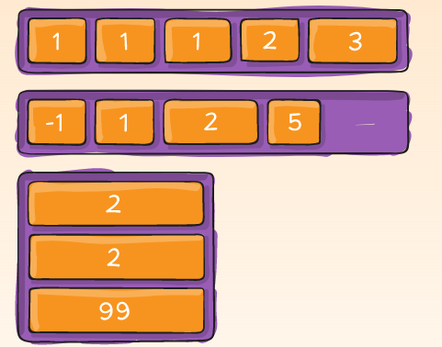
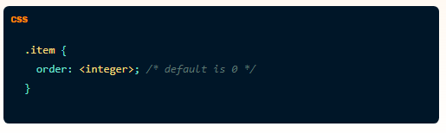
Order
flex items are laid out in the source order. However, the order property controls the order in which they appear in the flex container.

Slide 8
Gap
The gap property explicitly controls the space between flex items. It applies that spacing only between items not on the outer edges.
gap
row-gap
column-gap
The behavior could be thought of as a minimum gutter, as if the gutter is bigger somehow (because of something like justify-content: space-between;) then the gap will only take effect if that space would end up smaller.

Slide 9
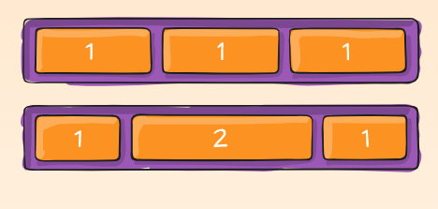
Flex-grow
The flex-grow property specifies how much the item will grow relative to the rest of the flexible items inside the same container.

Slide 10
Flex-shrink
The flex-shrink property specifies how the item will shrink relative to the rest of the flexible items inside the same container.
It’s a opposite to flex-grow

